Slide 1
Conception OBJET GRASP
General Responsibility Assignment Software Patterns

Slide 2
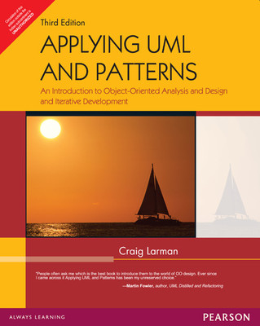
Grasp Patterns
Recognize that according to Craig Larman:
“The skillful assignment of responsibilities is extremely important in object design,
Determining the assignment of responsibilities often occurs during the creation of interaction diagrams and certainly during programming.”

Slide 3
Resources
www.unf.edu/~broggio/cen6017/38.DesignPatters-Part2.ppt
www.academic.marist.edu/~jzbv/.../DesignPatterns/GRASP.pp
…

Slide 4
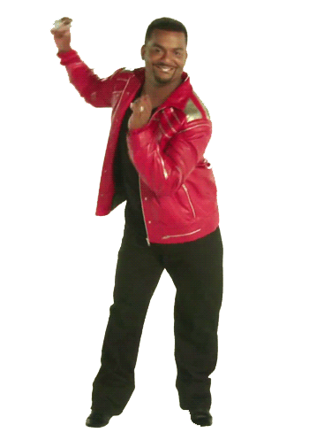
GRASP
During Object Design
Make choice about the assignment of responsibilities to software classes

Slide 5
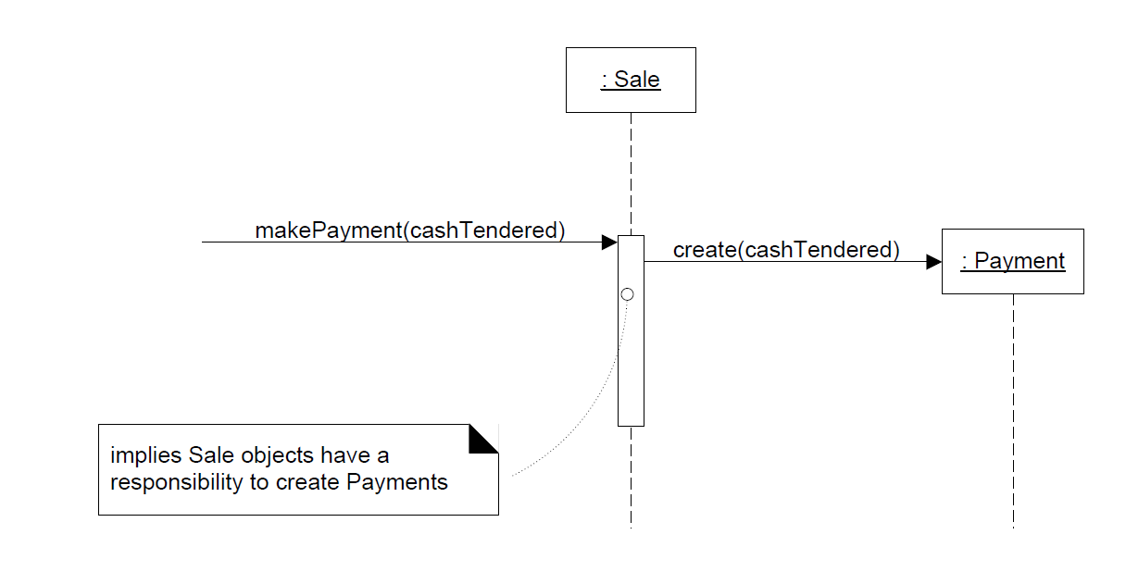
Responsibility

Slide 6
Expert
Sale example
Who is responsible for knowing the total of the sale ?
Who has the information to determine the total

Slide 7
(Information) Expert
Look in the Domain Model
Domain Model : conceptual classes
Design Model : software classes
So
Choose a domain model class
Create a new class based on Domain Model class

Slide 8
Expert– Using Domain Model
There is a Sale class in the domain model
Sale
date
time
1
Contains
*
Product
Specification
SalesLineItem
*
1
quantity
Described by
description
price
itemID

Slide 9
Add Sale Class to the design model
Add the responsibility of knowing its total
Method getTotal()
:Sale
date
time
New method ------→
getTotal()
t := getTotal()
: Sale

Slide 10
And then
What information is needed to determine the line item subtotals?
We need: SalesLineItem.quantity and
ProductSpecification.price
:Sale
date
time
getTotal()
t := getTotal()
1 *: st := getSubtotal()
: Sale
: SalesLineItem
:SalesLineItem
quantity
getSubtotal()

Slide 11
How the domain model is used
And we need to know the product price
The design class must include a method getPrice()
The design classes show how entities are used

Slide 12
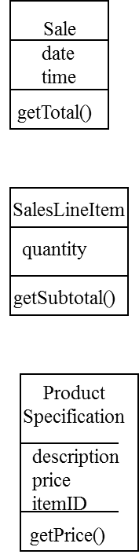
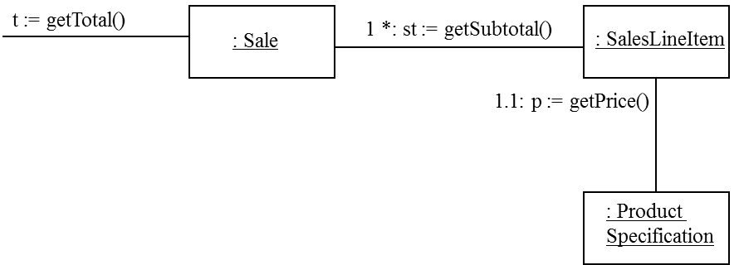
Finally
Responsabilities are placed with the object that had the information needed to fulfill it

Slide 13
Design Model considerations
Often requires spanning several classes
Collaboration between partial information experts
these “information experts” do things relative to the information they ‘know.’

Slide 14
Be careful
Who should be responsible for saving Sale in the database ?
Each entity cannot be responsible for that
Problem of
Cohesion and coupling
Reuse and duplication

Slide 15
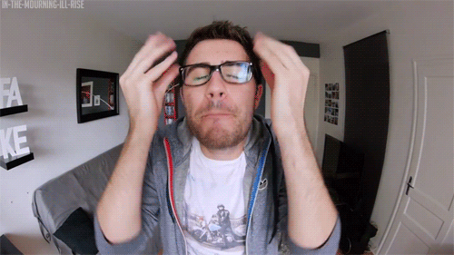
But why ???

Slide 16
Cohesion and Coupling
SQL/JDBC Code in the Sale Class
It is not anymore only a sale (decreased cohesion)
This is a new responsibility (saving itself)
(Separate I/O from data manipulation)

Slide 17
Cohesion and coupling
Coupling Sale with the database service
Sale belong to the domain layer
Coupled to other domain objects
Difficult to change the storage service

Slide 18
Final : be careful
Keep application logic in one place
Keep database logic in another place
Separation of concern is good for cohesion and coupling

Slide 19
Benefits of expert
Maintain encapsulation
Supports low coupling
Behavior distributed accross classes that have the required information
High cohesion, Better reuse

Slide 20

Creator
Who is responsible for creating new instances of some classes

Slide 21
Solution
Assign class B the responsibility to create an instance of class A if one or more of the following is true:
B aggregates A (simple aggregate; shared attributes)
B contains A (composition; non-shared attributes)
B records instances of A objects
B closely uses A objects
B has the initializing data that will be passed to A when it is created (thus B is an Expert with respect to creating A)
e.g. queue collection class; queue driver class; stack ….
If more than one option applies, prefer a class B which aggregates or contains class A.

Slide 22
Creator
Creation of objects is very common
We have a State class and we create instances of State objects, or
We have a CD class, and we create instances (an array?) of CD objects….
Creator results in low coupling, increased clarity, encapsulation and reusability

Slide 23
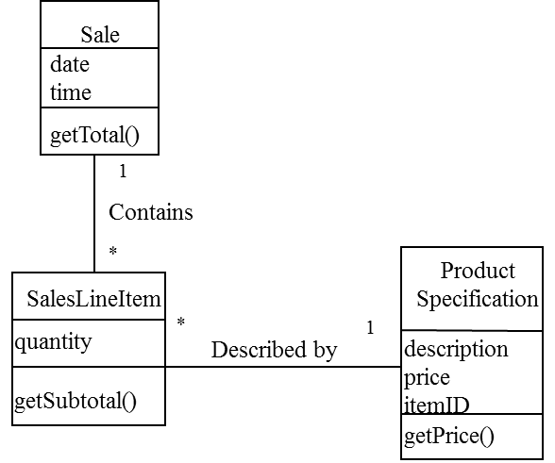
Creator Example
Who is responsible for creating SalesLineItem

Slide 24
Sale aggregates SalesLineItems
Sale is a good candidate to have the responsibility of creating SalesLineItems
Seems very obvious

Slide 25
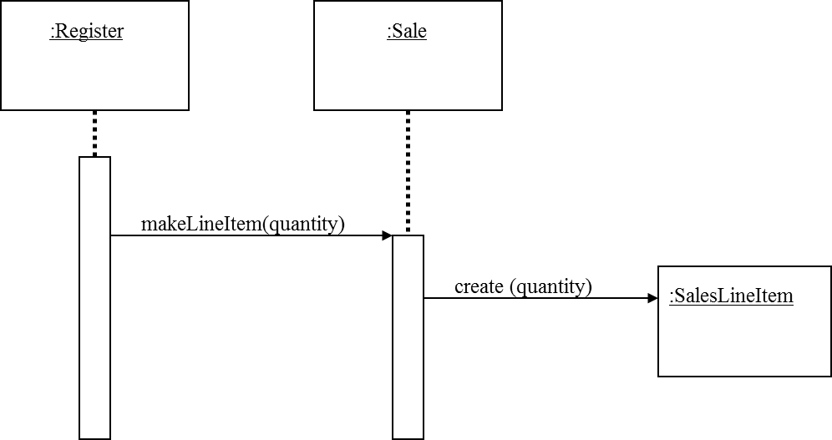
The sequence diagram helps

Slide 26
Benefits
Creator connected to the created object
Creator has the initializing data needed for the creation
Cf Larman book
Creator is a kind of expert

Slide 27
Creator
Sometimes it is better to delegate creation to a helper Class
The Factory design pattern

Slide 28
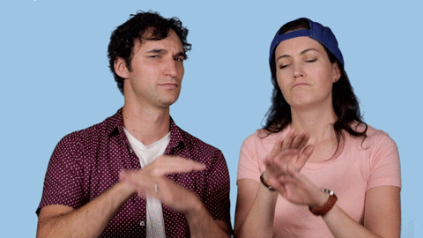
Low Coupling
Assign a responsibility to keep the coupling low
Support low dependency, low change impact and increased use
High coupling is not desirable
Hard to change, understand, reuse

Slide 29
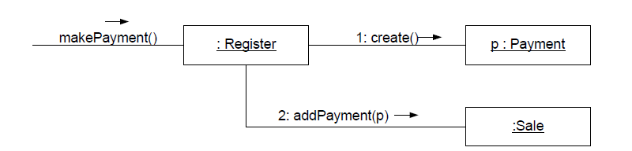
Example
Register is coupled to payment

Slide 30
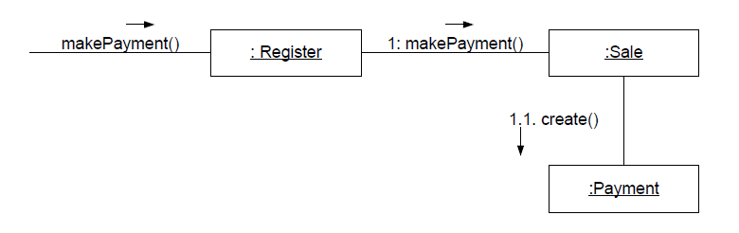
Alternative
Payment known from Sale. Sale has to know Payment

Slide 31
Common form of coupling
TypeX has an attribute that refers to TypeY
TypeX instance call a service on a TypeY instance
TypeX has a method that references an instance of TypeY (parameter, local variable)
TypeX is a subclass of TypeY
TypeY is an interface and TypeX implements it

Slide 32

High Cohesion
Assign responsibility to keep cohesion high
Measure of the relation between an element responsibilities
Low cohesion mean
Hard to comprehend, reuse and maintain

Slide 33
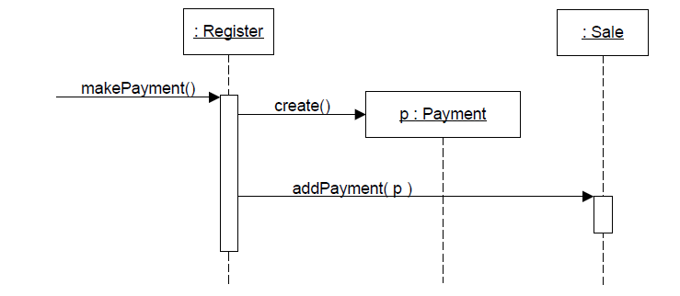
Example
Register creates payment

Slide 34
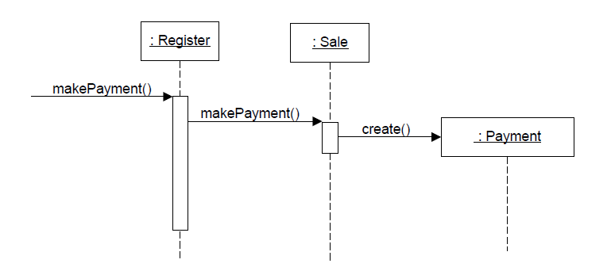
Same alternative
Register has less responsibilities – Higher cohesion

Slide 35
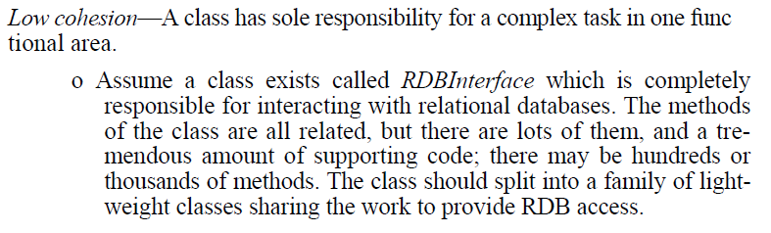
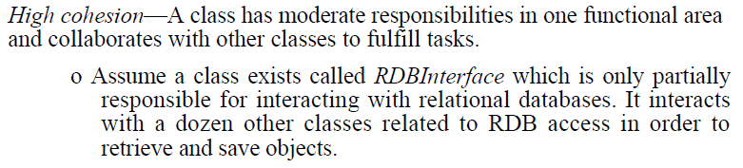
Scenarios (Booch94)

Slide 36
Controller
Assign the responsibility for handling event message
Facade Controller
Use Case or Session controler
This is not a UI class
Who is responsible for handling input system event

Slide 37
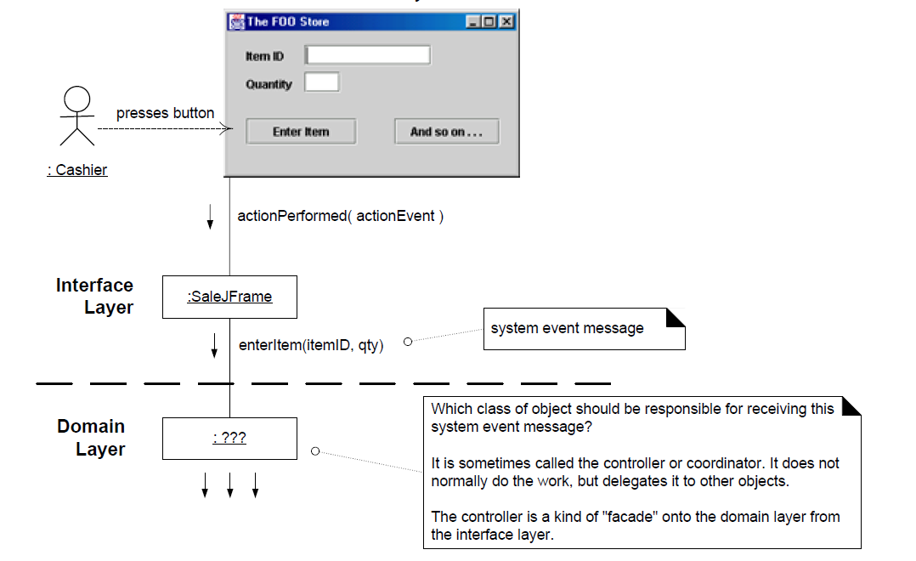
Example

Slide 38
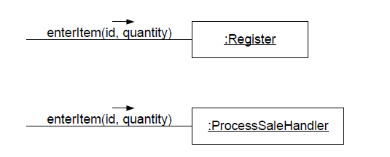
Two possibilities

Slide 39

The controller delegates
It does not do the work by itself
It coordinates/controls the activity

Slide 40
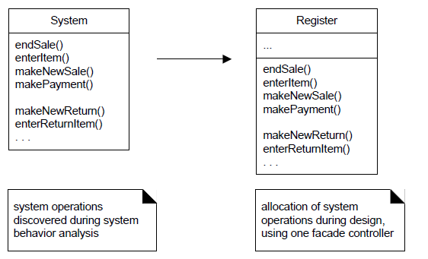
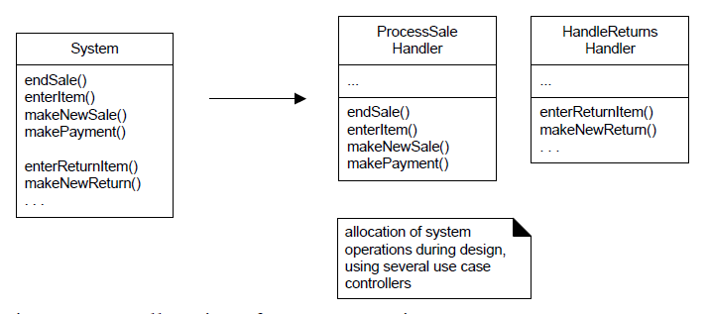
Allocation of operations

Slide 41
Issues
Avoid bloated controllers (low cohesion)
Add more controllers
The controller delegates the responsibility to fulfill operation on to other objects.

Slide 42
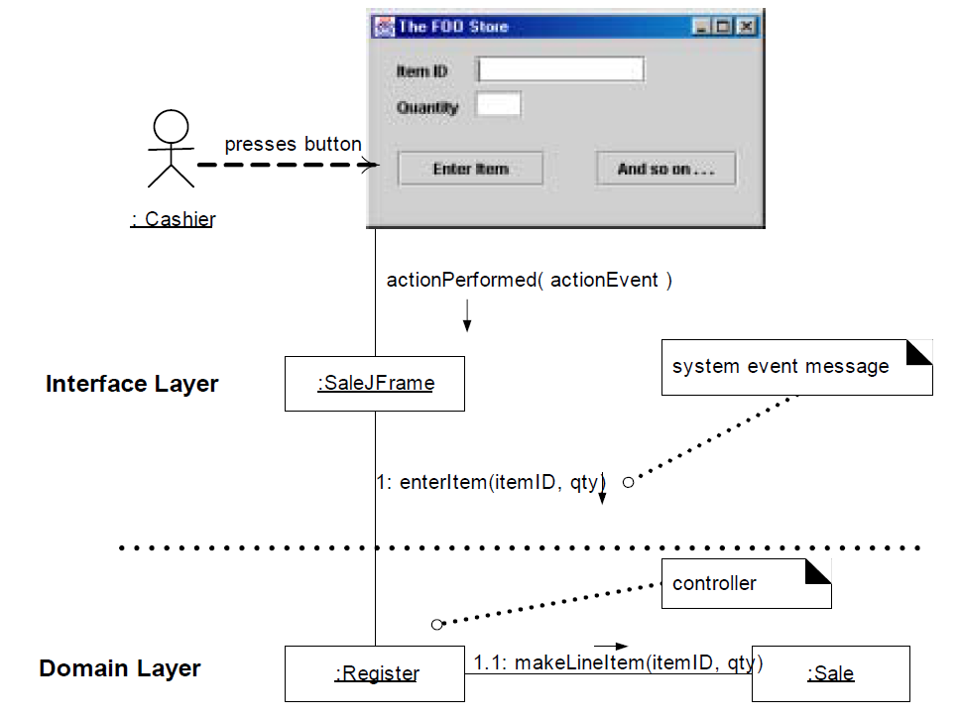
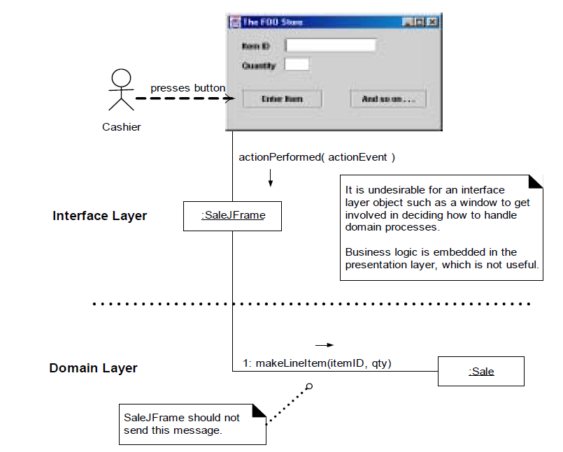
Two couples

Slide 43
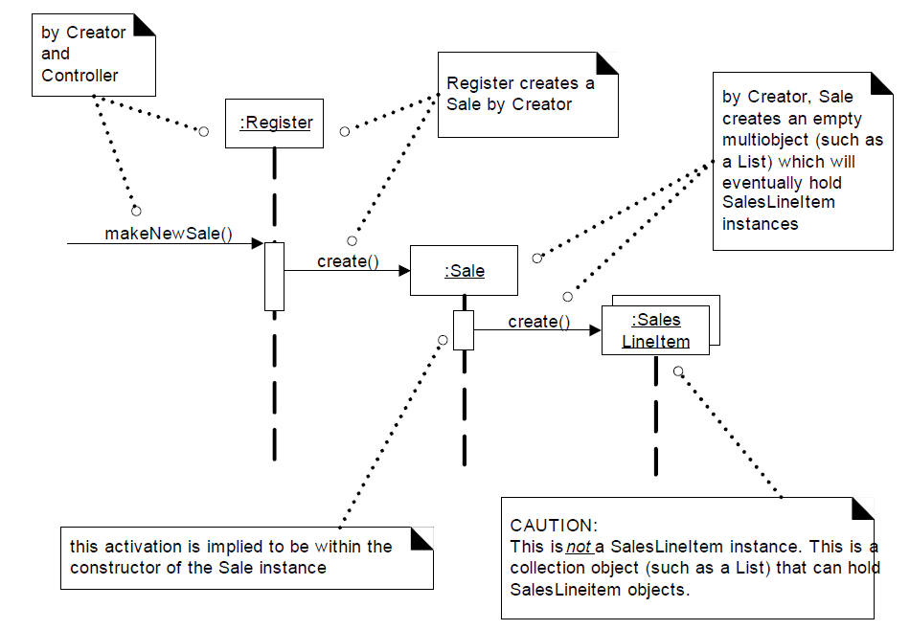
Creating a Sale

Slide 44
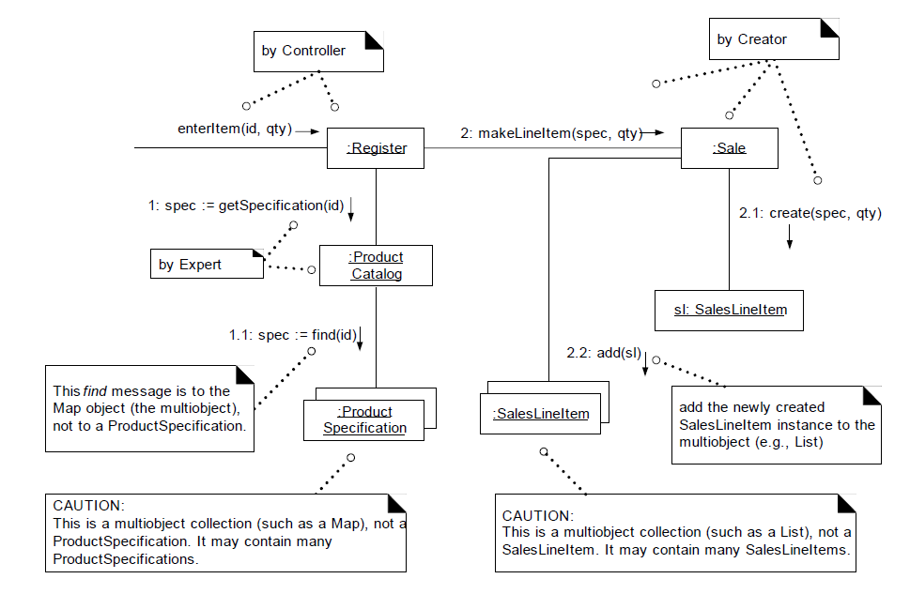
Enter an Item to the Sale

Slide 45
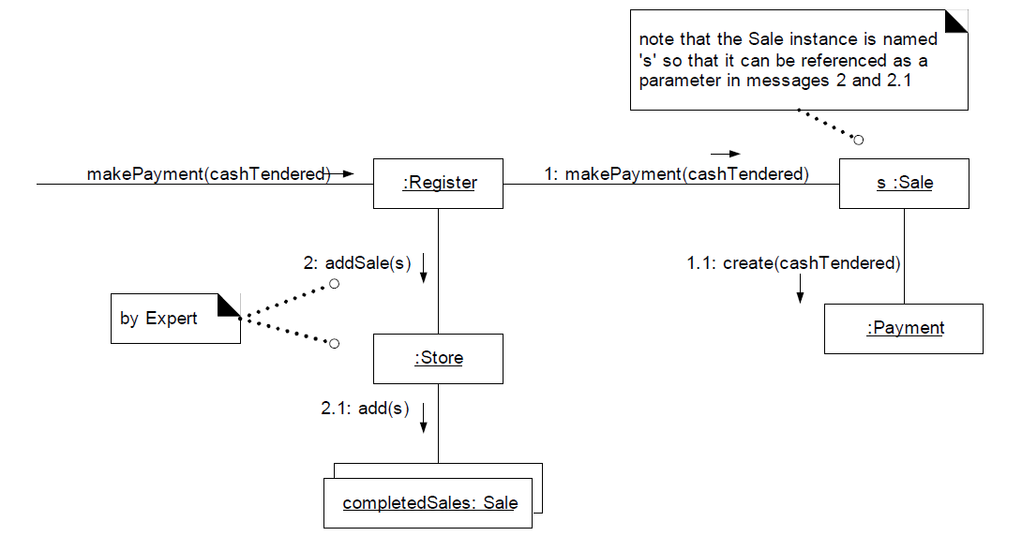
Making payment

Slide 46
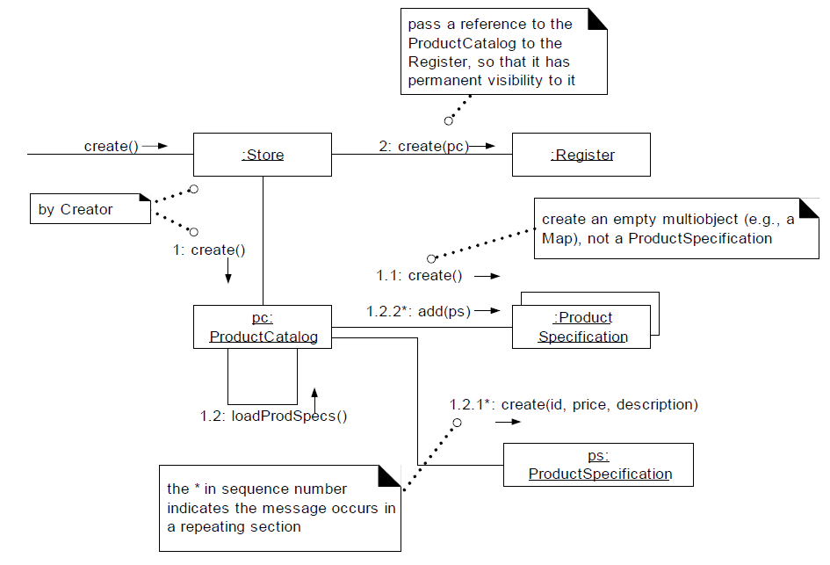
Initialisation

Slide 47
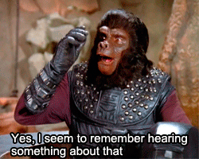
Remember
Low Coupling/High Cohesion
Expert
Creator
Controller
Not exactly patterns but strong guidelines.

Slide 48
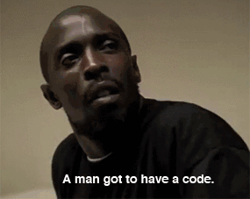
More principles
Polymorphism
Indirection
Pure Fabrication
Protected Variation

Slide 49
Polymorphism
When behavior vary by type assign the responsibility to the type for which the type vary.
Corollary: Do not test for the type of an object and use conditional logic to perform varying alternatives based on type.
How to create pluggable component ? How to handle alternatives based on types ?

Slide 50
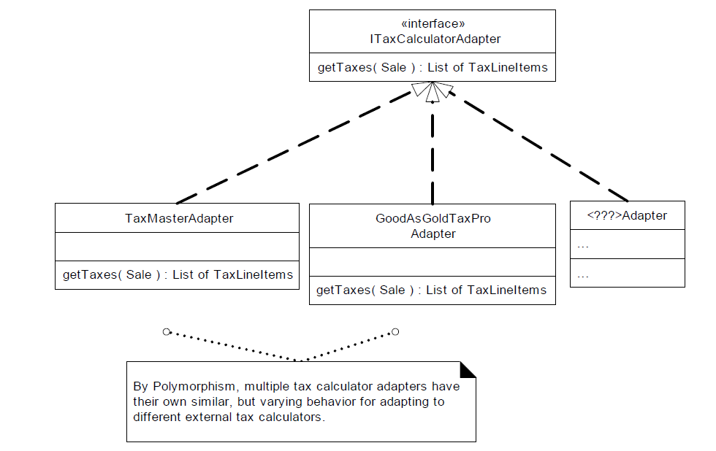
Example : Multiple tax calculator

Slide 51
Final
Very easy to extend and add variations
New implementations can be added with affecting the client
Do it only if there are known variations (no future proofing)

Slide 52
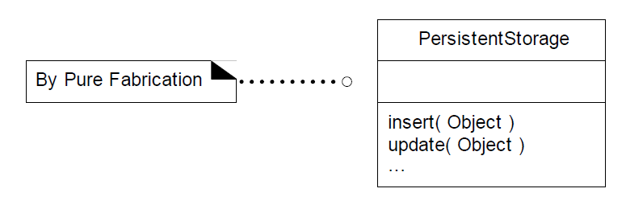
Pure Fabrication
A class to save cohesion and coupling – a creation of imagination

Slide 53
Indirection
Assign the responsibility to an intermediate object to mediate between component or services so that they are not directly coupled
How to decouple objects to increase reuse.

Slide 54
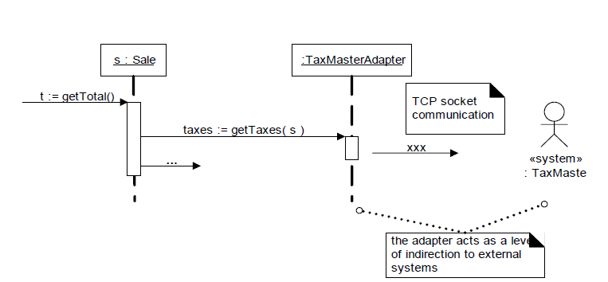
Example : an adapter

Slide 55
Finally
Reduce coupling
Protect from variations
Indirections are often Pure Fabrication
PersistenceStorage

Slide 56
Protected Variation
Identify points of predicted variation and instability. Assign responsibilities to create a stable interface around them

